Slide 1
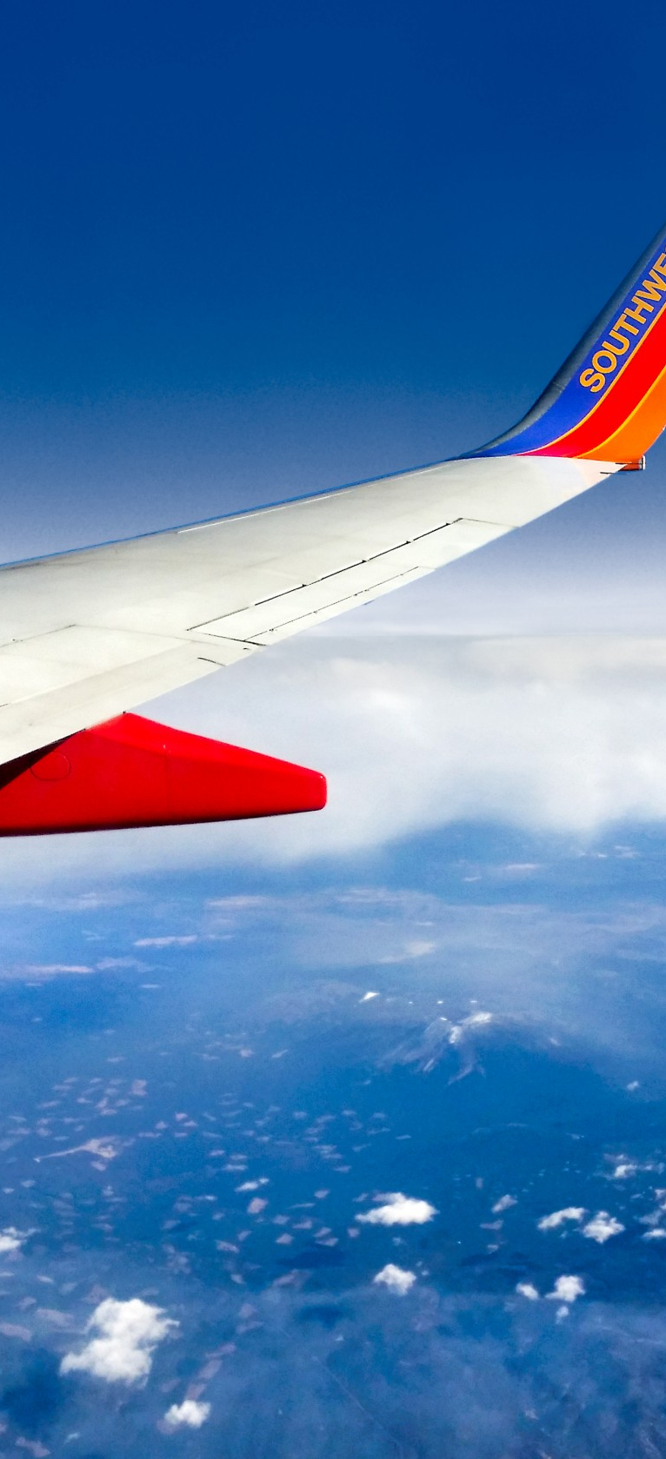
Airline Performance & Delay Analysis

Slide 2



Flight Delays: The Silent Cost to Airlines and Passengers
The Silent Cost
Objectives
'In an industry where time is the ultimate currency, a 19.08% delay rate across 121 million flights over the represents a staggering Silent Cost. How do these minutes translate into millions in lost revenue and eroded passenger trust?'
WHEN: Identifying the Seasonal Pulse of delays
WHERE: Identifying Geographic Bottlenecks and Operational Inefficiencies
WHY: Exposing the Root Cause and the 'Domino Effect' of late aircraft

Slide 3
Dataset Overview & Analytical Approach
Multi-Year Dataset
Analytical Methodology
Historical airline operations data aggregated by month, capturing comprehensive flight performance metrics across carriers and airports.
Exploratory Data Analysis focused on KPI-based evaluation to understand operational inefficiencies and their root causes.
Key Metrics Analyzed
Analysis Framework
Delay Rate calculation
Cancellation Rate analysis
Average Delay assessment
Comparative analysis across airlines, airports, and time periods
Total flights (arr_flights)
Delayed flights (arr_del15)
Cancellations (arr_cancelled)
On-Time-Performance

Slide 4




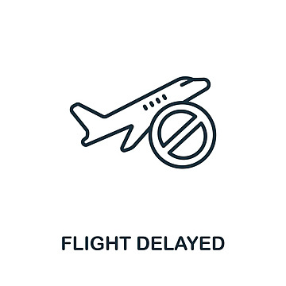
KPIs - Key Performance Indicators
121 M
Total Flights
Total Flights represents the overall airline operations, forming the baseline for performance and delay analysis.
On-Time Performance measures flight punctuality, indicating reliability and schedule efficiency.
Cancellation Rate shows the proportion of cancelled flights, reflecting operational disruptions.
Delay Rate indicates the percentage of delayed flights, highlighting inefficiencies in operations.
84.95
On-Time Performance
2.72
Cancellation rate
19.08
Delay Rate

Slide 5
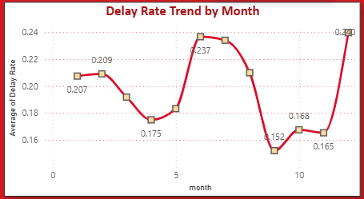

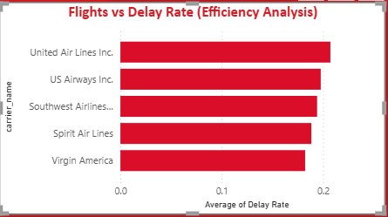
Key Insights -1
Seasonal Peak Drive Delays
Delay rates peak during mid-year and December, indicating strong seasonal travel impact.
Lower delays around September suggest improved operational stability during off-peak periods.
“Delays are not random events, they follow seasonal demand pressure.”
Operational Efficiency Varies
Some airlines consistently record higher delay rates, reflecting operational inefficiencies.
Performance variation highlights differences in scheduling, resource management, and capacity handling.

Slide 6
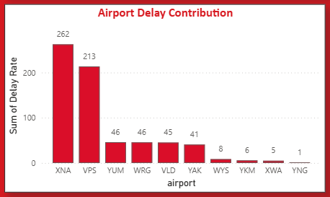
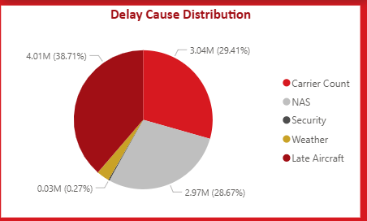
Key Insights -2
Geographic Concentration
A small number of airports contribute disproportionately to total delays.
This suggests congestion and infrastructure limitations in high-traffic regions.
Late Aircraft Dominates
Carrier and late aircraft delays form the largest share of total delays.
External factors like weather and security have relatively minimal impact.
“Airline delays are not isolated incidents –
They are chain reactions.”

Slide 7




Strategic Recommendations
Control Delay Propagation
Optimize Scheduling
Add strategic buffers for high-risk flights to break the chain reaction of late aircraft delays.
Reduce congestion during peak hours and redistribute traffic across less congested time slots.
Smart Cancellation Strategy
Weather Preparedness
Cancel flights early rather than repeated delays to minimize passenger disruption and operational costs.
Pre-adjust schedules based on forecast data to proactively manage weather-related disruptions.
Instead of eliminating delays completely, focus on controlling how delays spread across the system to minimize cascading effects.

Slide 8
Assumptions & Limitations
Assumptions
Future Enhancement Opportunities
Historical patterns accurately reflect real-world operations
Delay categorization is consistent and reliable
Aggregated monthly data represents operational reality
01
Predictive Delay Modeling
Machine learning models to forecast delay probabilities
02
Limitations
Real-Time Weather Integration
No real-time operational data available
No passenger-level insights or experiences
External disruptions not fully captured
Live weather data feeds for
dynamic scheduling
03
Network Optimization
System-wide approach to delay
management

